Slide 1
CEP SPEAKING
PRACTICE
Ecological Waste:
Reducing Clothing Waste
CEP Set 1 • Lesson 2 • Speaking Practice

Slide 2
01 WARM-UP
Warm-up
QUESTION 1 (Student A)
QUESTION 2 (Student B)
Do you like shopping for new clothes?
What do you do with the new clothes you no longer want?
2

Slide 3
02 BUILD IDEAS
What are some examples of fast fashion and second-hand shopping?
• cheap prices, new styles every week
• trendy “wear-once” items
• global brands, huge scale
• charity & thrift shops
• buy and sell online (Carousell)
• swaps, hand-me-downs, upcycling
FAST FASHION
SECOND-HAND & REUSE
SHEIN
Zara
H&M
Uniqlo
TEMU
Carousell
Thrift shops
Clothing swap
Upcycling
3

Slide 4
02 BUILD IDEAS
What is the current situation of clothing waste?
8% of textile fibres are recycled (2023) – 11% of plastic waste is clothing
92
million tonnes of textile waste
2026 EU bans companies from destroying unsold clothes (EU Parliament)
are produced worldwide every year.
Source: UNEP, March 2025
• production doubled from 2000 to 2015
• garment wear time fell by 36%
HK 'Green in, Green out' EPD clothing bins + charity collection points
4

Slide 5
07 DISCUSS
Skill: Connecting and building on ideas
A: I think buying cheap clothes is a good idea because students don’t have much pocket money.
B: I agree with Candidate A that buying cheap clothes is a good idea for students.
B*: Candidate A made a good point about students’ budgets. However, I think cheap clothes come with a hidden cost. For instance, the UN reported that the world produces 92 million tonnes of textile waste every year, and much of it ends up in landfills. So for students like us, buying fewer, better-made clothes is smarter – they last longer and save money in the long run. Any other thoughts?
5

Slide 6
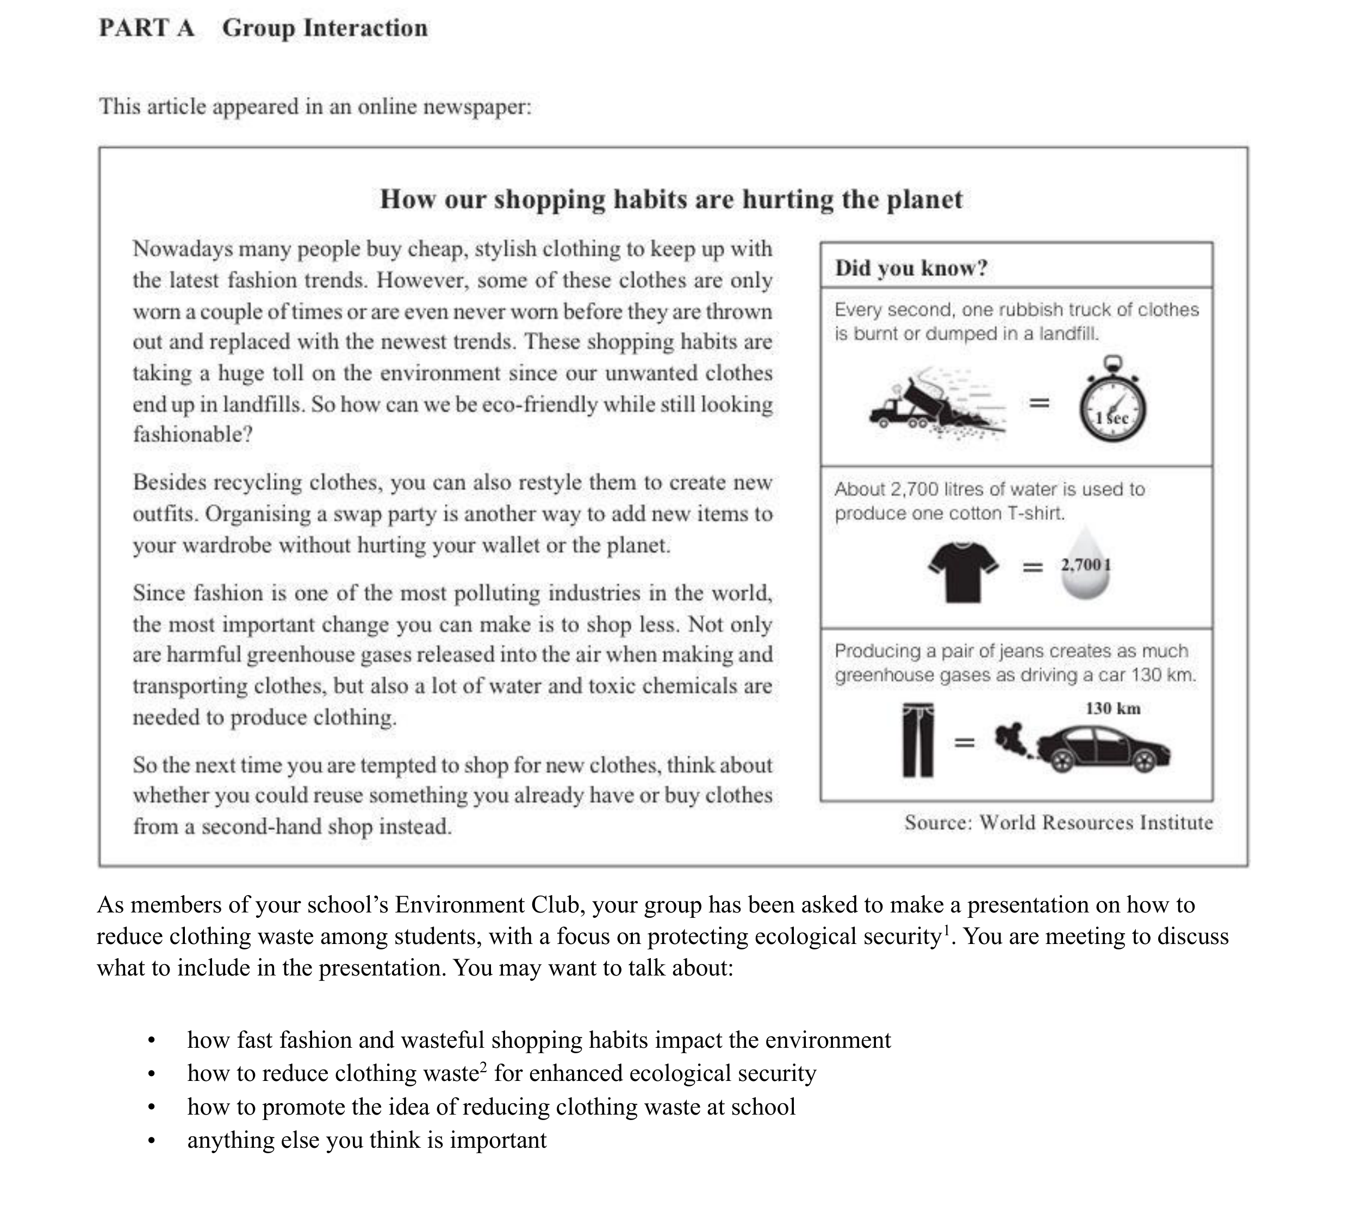
07 DISCUSS
Part A:
Group Interaction
Environment Club task: a presentation on reducing clothing waste among students
• how fast fashion & wasteful habits impact the environment
• how to reduce clothing waste for enhanced ecological security
• how to promote reducing clothing waste at school
• anything else you think is important
Turn-taking: invite others • build on ideas • stay on topic
6

Slide 7
08 SPEAK FOR 30–45 SECONDS
Part B: Individual Response practice
What are some of the pros and cons of buying cheap clothes?
Pros: affordable, trendy, more variety for the same budget
Cons: poor quality, more waste, hidden environmental cost
Do you think quality or quantity of clothes is more important?
Quality: lasts longer, better value per wear, less waste
Quantity: more variety, self-expression, practical for teens
7

